Slide 1






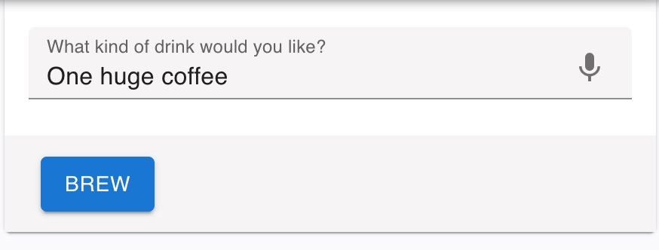
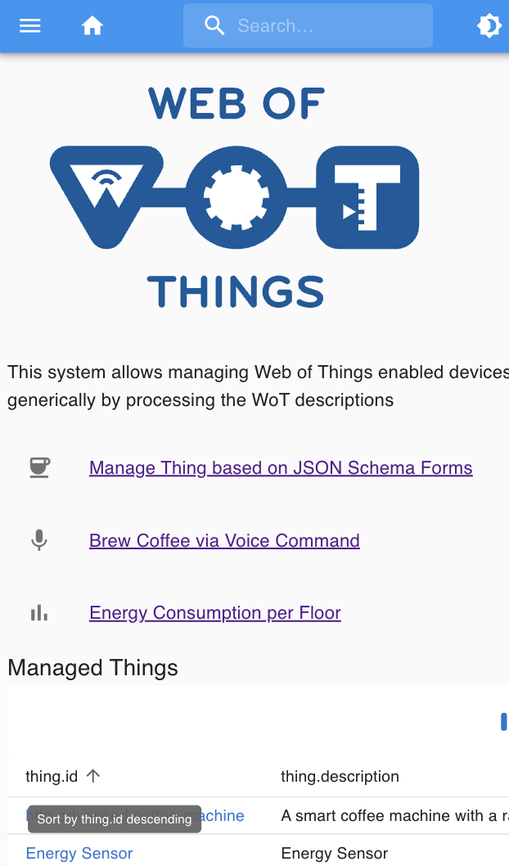
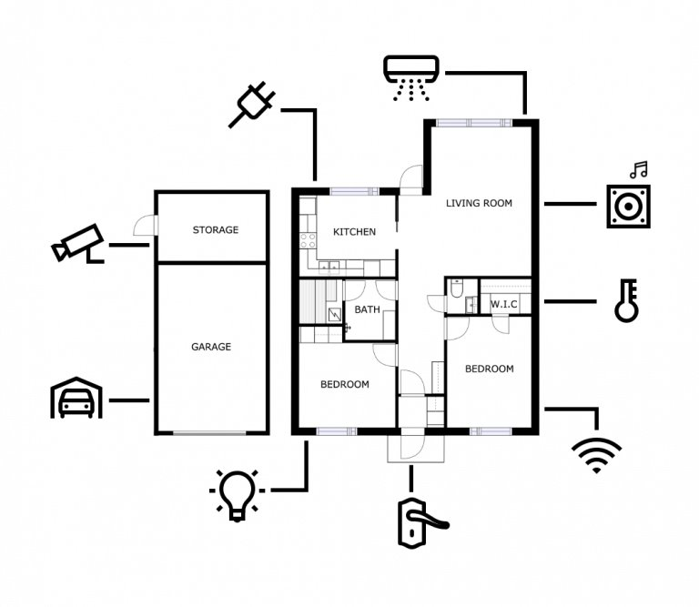
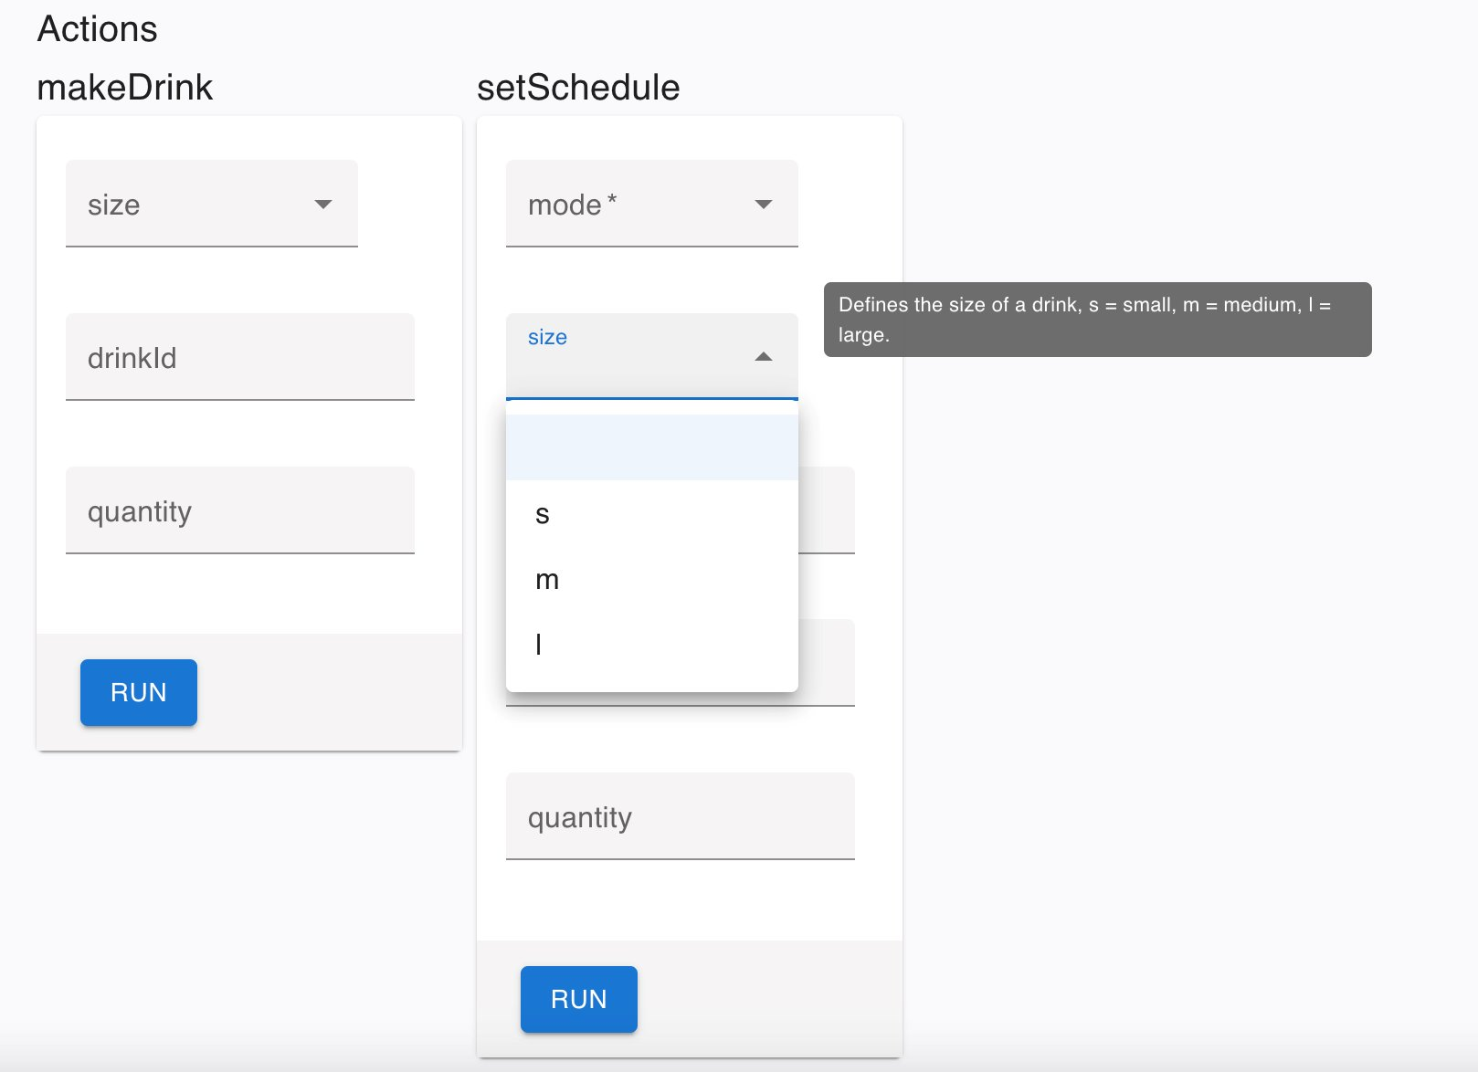
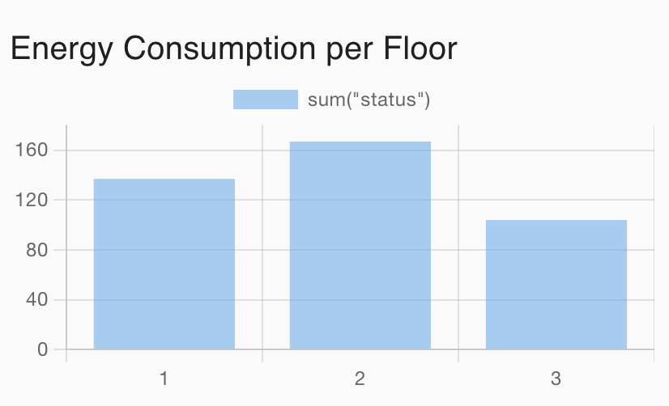
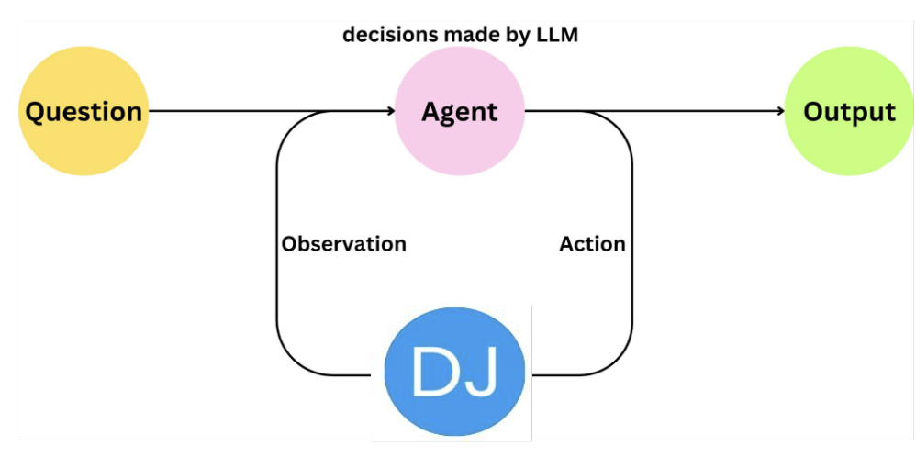
Generic & AI Enabled WoT Manager Connect & Manage Any Thing
Discovery, Security & RBAC
Natural Language Commands
Integrate Background Knowledge on Devices
Generic Thing Visualization & Control
Dashboards powered by Semantic Data Harmonization
AI Agent fulfills higher lever goals

